Slide 1


Slide 2
Section 0
Course Overview

Slide 3


Section 0 - Course Introduction and Set-up
Welcome to the Course!
This section is Section 0
We quickly cover how the course is structured and do some quick set-up so you can hit the ground running on Section 1, which is where the real work begins!

Slide 4
Section 0 - Course Introduction and Set-up
Section 0 Topics:
Course Design
Version Control Concepts
Optional Command Line Overview

Slide 5
Section 0 - Course Introduction and Set-up
Course Design Overview

Slide 6
Section 0 - Course Introduction and Set-up
Course Design Overview
This course is designed following the “80/20” principle.
With git and Github, 80% of the time you’re just going to use about 20% of the available git commands.
We want to teach you the most common git use cases quickly!

Slide 7
Section 0 - Course Introduction and Set-up
Course Design Overview
Often git, GitHub, and version control experience are required at the very start of a new job or new project.
We’ve designed this course to be completed in 5 Sections with just about 1 hour a Section of study.

Slide 8
Section 0 - Course Introduction and Set-up
Course Design Overview
The goal of this course is for someone with little to no git experience to quickly get up to speed on the most common use cases for git and GitHub and then also have the knowledge and skills to find out any other less common git methods they need to learn in the future.

Slide 9
Section 0 - Course Introduction and Set-up
Course Design Overview
Each section is structured after a “Section”, where this is Section 0 (planning and overview) and then Sections 1-5 are where the real git and GitHub learning take place.

Slide 10
Section 0 - Course Introduction and Set-up
Course Design Overview
Each section ends with an exercise to check your understanding.
Let’s quickly go through the material learned on each Section…

Slide 11
Section 0 - Course Introduction and Set-up
Course Design Overview
Section 0:
Course Design Overview
Version Control Concepts
Optional Command Line Overview
Windows Users
MacOS/Linux Users

Slide 12
Section 0 - Course Introduction and Set-up
Course Design Overview
Section 1: Repository Basics
Source Code Management
Git Overview
Install and Setup Git and GitHub
Understanding Code Repositories
Cloning Repositories

Slide 13
Section 0 - Course Introduction and Set-up
Course Design Overview
Section 1: Repository Basics
After Section 1, you will be able to create a code repository on GitHub and clone it to your local computer.

Slide 14
Section 0 - Course Introduction and Set-up
Course Design Overview
Section 2: Getting Started with Git
Updating Code in Repository:
git status
git add
git commit
git diff
git push
git pull

Slide 15
Section 0 - Course Introduction and Set-up
Course Design Overview
Section 2: Getting Started with Git
After Section 2, you will be able to edit your local code, and then push those changes to the code that is hosted on the internet (on GitHub).

Slide 16
Section 0 - Course Introduction and Set-up
Course Design Overview
Section 3: Working with Others with git
Focus on using git with branches.
Branches allow you to split off code development to others and then later bring back and merge that code into the main branch.

Slide 17
Section 0 - Course Introduction and Set-up
Course Design Overview
Section 3: Working with Others with git
At the end of Section 3 you will be able to work with git branches which allow you to work on the same code base with other people.

Slide 18
Section 0 - Course Introduction and Set-up
Course Design Overview
Section 4: Undoing Changes
We’ll cover commands such as git log, git amend, and how to rollback code bases to a previous commit.

Slide 19
Section 0 - Course Introduction and Set-up
Course Design Overview
Section 4: Undoing Changes
At the end of Section 4 you will understand the different methods of undoing changes previously pushed to the main code repository.

Slide 20
Section 0 - Course Introduction and Set-up
Course Design Overview
Section 5: Git in Practice
On your last Section we cover a quick tour of some useful GitHub features and other useful git commands, such as git clean and different git extensions available.

Slide 21
Section 0 - Course Introduction and Set-up
Course Design Overview
Section 5: Git in Practice
At the end of Section 5 you will understand a variety of different commands as well as some useful tools within GitHub.

Slide 22
Section 0 - Course Introduction and Set-up
That’s everything you’ll learn in just 5 Sections!
Now let’s move on to quickly cover the main ideas behind version control, this lecture is technically optional if you already understand the intuition or motivation behind using version control systems like git.

Slide 23
Section 0
Version Control Overview

Slide 24
Section 0 - Course Introduction and Set-up
Before we jump into the world of git and GitHub, let’s have an optional overview of version control.

Slide 25
Section 0 - Course Introduction and Set-up
Version Control

Slide 26
Section 0 - Course Introduction and Set-up
Version Control
When working with digital files, whether is a .docx Word file or a programming .py Python file, you probably don’t finish all your work at once.
In this case, the software you use to manage and track changes in these files is your version control.

Slide 27
Section 0 - Course Introduction and Set-up
Version Control
You could create your own version control system, such as using multiple files:
My_Paper.docx

Slide 28
Section 0 - Course Introduction and Set-up
Version Control
You could create your own version control system, such as using multiple files:
My_Paper.docx
My_Paper_v2.docx

Slide 29
Section 0 - Course Introduction and Set-up
Version Control
You could create your own version control system, such as using multiple files:
My_Paper.docx
My_Paper_v2.docx
My_Paper_Final.docx

Slide 30
Section 0 - Course Introduction and Set-up
Version Control
You could create your own version control system, such as using multiple files:
My_Paper.docx
My_Paper_v2.docx
My_Paper_Final.docx
My_Paper_Actual_Final.docx

Slide 31
Section 0 - Course Introduction and Set-up
Version Control
You could create your own version control system, such as using multiple files:
My_Paper.docx
My_Paper_v2.docx
My_Paper_Final.docx
My_Paper_Actual_Final.docx

Slide 32
Section 0 - Course Introduction and Set-up
Version Control
Alternatively, you could decide just to keep updating the same file over and over again.
But what happens if you want to go back to a historical version, perhaps because of a bug in your newest version?
What if you want to work with others on the same code?

Slide 33
Section 0 - Course Introduction and Set-up
Version Control
Clearly we need a more robust system that can allow us to work on the same file, yet retain information about previous versions.
A version control system (VCS) allows us to track changes, undo changes, compare versions, work with others, and more!

Slide 34
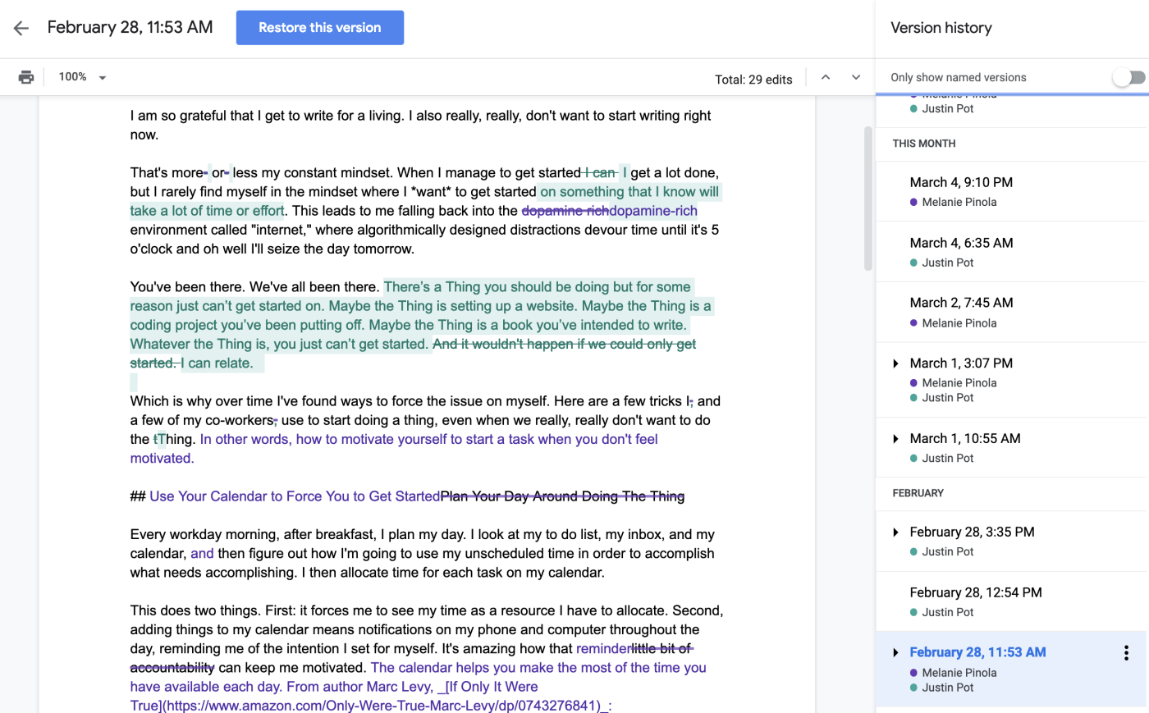
Section 0 - Course Introduction and Set-up
Version Control
Version control is starting to become more common in consumer tools:

Slide 35
Section 0 - Course Introduction and Set-up
Version Control
Git itself is one example of a VCS, and while there are others (subversion, mercurial, etc…), git is by far the most popular VCS in the world.
Fortunately for us git is free and open-source and we can download it to our own computer.

Slide 36
Section 0 - Course Introduction and Set-up
Version Control
What is GitHub? (or GitLab?)
You can use git completely free locally, and use it to track changes on your local files on your own computer.
However if you want to host your code on the internet, its typically easier to use a hosting service like GitHub.

Slide 37
Section 0 - Course Introduction and Set-up
Version Control
What is GitHub? (or GitLab?)
GitHub (owned by Microsoft) integrates easily with git and allows you to have versions of your code “live” on the internet for you and others to access, update, and change from any machine.

Slide 38
Section 0 - Course Introduction and Set-up
Version Control
GitHub vs. git
GitHub is not the same thing as “git”.
Git:
Open source VCS software.
GitHub:
Company that operates a service for hosting files on the internet that are managed using git.

Slide 39
Section 0 - Course Introduction and Set-up
Version Control
Let’s briefly visualize how .git would work on a simple file.
Keep in mind, we’ll do a much deeper dive into all of this in Sections 1-5!

Slide 40
Section 0 - Course Introduction and Set-up
Initial
Project

Slide 41
Section 0 - Course Introduction and Set-up
Initial
Project
Add Code
Add Code

Slide 42
Section 0 - Course Introduction and Set-up
Initial
Project
Add Code
More Code
Add Code
Add
More Code

Slide 43
Section 0 - Course Introduction and Set-up
Initial
Project
Add Code
More Code
Very New Code
Add Code
Add
More Code
Very New Code

Slide 44

Section 0 - Course Introduction and Set-up
Initial
Project
Add Code
More Code
Very New Code
Add Code
Add
More Code
Very New Code

Slide 45
Section 0 - Course Introduction and Set-up
Initial
Project
Add Code
More Code
Very New Code
Add Code
Add
More Code
Very New Code

Slide 46
Section 0 - Course Introduction and Set-up
Initial
Project
Add Code
More Code
Add Code
Add
More Code

Slide 47
Section 0 - Course Introduction and Set-up
Initial
Project
Add Code
More Code
Add Code
More Code
Add Code
Add
More Code
Add
More Code

Slide 48
Section 0 - Course Introduction and Set-up
Initial
Project
Add Code
More Code
Branch Code
Add Code
More Code
Add Code
Add
More Code
Add
More Code
Branch
Code

Slide 49
Section 0 - Course Introduction and Set-up
Initial
Project
Add Code
More Code
Branch Code
Add Code
More Code
Add Code
Add
More Code
Add
More Code
Branch
Code
Merged
Version

Slide 50
Section 0 - Course Introduction and Set-up
Initial
Project
Add Code
More Code
Branch Code
Add Code
More Code
Add Code
More Code
Branch Code
Add Code
Add
More Code
Add
More Code
Branch
Code
Merged
Version

Slide 51
Section 0 - Course Introduction and Set-up
Version Control
A VCS such as git allows you to add “save points” to your work, create changes, update existing code, undo changes, create branches for others to work on, and merge work together.

Slide 52
Section 0 - Course Introduction and Set-up
Up Next:
We’ll have optional command line review lectures.
Git commands are written at the command line, so navigating the command line is a required skill, but don’t worry, it’s just a few simple commands to remember!

Slide 53
Section 0
Optional:
Windows Command Prompt

Slide 54
Section 0 - Course Introduction and Set-up
Windows Command Prompt
In this lecture we’ll cover how to use the command prompt to do the following:
Change Directories (cd)
Make a New Directory (mkdir)
List files in current directory (dir)

Slide 55
Section 0 - Course Introduction and Set-up
Windows Command Prompt
Important Note for OneDrive Users:
Try to avoid operating inside a OneDrive folder as it may cause issues, since OneDrive also acts as its own versioning system depending on settings.

Slide 56
Section 0
Optional:
MacOS/Linux
Command Line

Slide 57
Section 0 - Course Introduction and Set-up
MacOS or Linux Terminal
In this lecture we’ll cover how to use the command line at the terminal to do the following:
Change Directories (cd)
Print Current Directory (pwd)
List files in current directory (ls)

